Slide 1
EMBEDDED SYSTEM DESIGN LAB
Lab Instructor..
Engr. Syed Zia Uddin
B.Engg. (Electrical) , M.Engg(Industrial Electronics)
Lab Engineer , Department of Electrical Engineering Bahria University Karachi

Slide 2
LAB # 09 : Serial peripheral interfacing
Serial peripheral interface (SPI) is one of the most widely used interfaces between microcontroller and peripheral ICs.
SPI is a synchronous, full duplex master-slave-based interface. The data from the master or the slave is synchronized on the rising or falling clock edge. Both master and slave can transmit data at the same time. The SPI interface can be either 3-wire or 4-wire. This article focuses on the popular 4-wire SPI interface

Slide 3
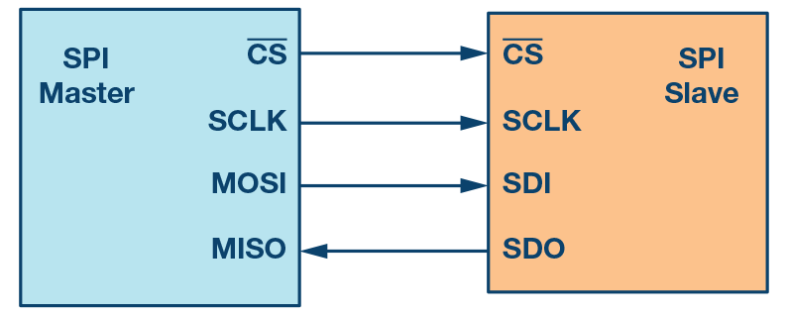
SPI
SPI uses the following four wires −
SCK − This is the serial clock driven by the master.
MOSI − This is the master output / slave input driven by the master.
MISO − This is the master input / slave output driven by the master.
SS − This is the slave-selection wire.

Slide 4
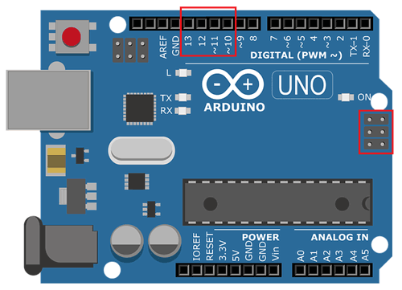
SPI-ARDUINO UNO
Arduino UNO has pin # 10,11,12,13 for SPI communication.
MOSI at Pin # 11 , MISO at Pin # 12 , SCK at Pin # 13, SS at Pin # 10

Slide 5
SPI LIBRARY ARDUINO
To use the library , #include <SPI.h>
LIBRARY FUNCTIONS:
SPI.begin() // Initializes the SPI bus by setting SCK, MOSI, and SS to outputs, pulling SCK and MOSI low, and SS high.
SPI.end() // Disables the SPI bus (leaving pin modes unchanged
SPI.beginTransaction(SPISettings(speedMaximum, dataOrder, dataMode)) − speedMaximum is the clock, dataOrder(MSBFIRST or LSBFIRST), dataMode(SPI_MODE0, SPI_MODE1, SPI_MODE2, or SPI_MODE3)
SPI.endTransaction()

Slide 6
SPI LIBRARY ARDUINO
LIBRARY FUNCTIONS:
SPI.setClockDivider(divider)
SPI.transfer(val)
SPI.attachInterrupt() // Function to be called when a slave device receives data from the master.
SPI REGISTERS IN AVR ATMEGA 328P :
1. SPCR – SPI CONTROL REGISTER
2. SPSR – SPI STATUS REGISTER
3. SPDR – SPI DATA REGISTER

Slide 7
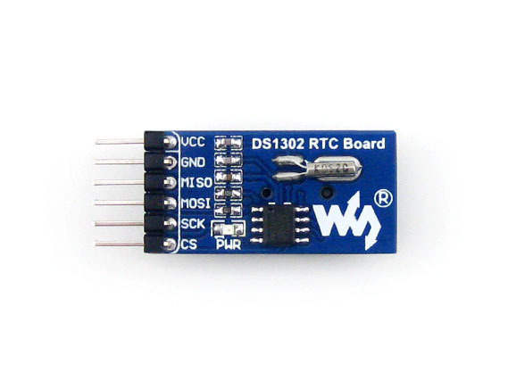
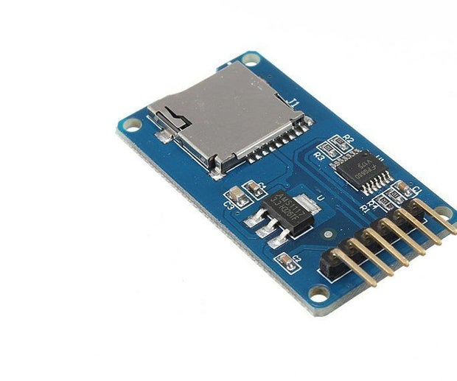
SPI ENABLED MODULES: Few examples…..

